Slide 1
Fetch Rewards Coding Exercise - Data Analyst

Slide 2
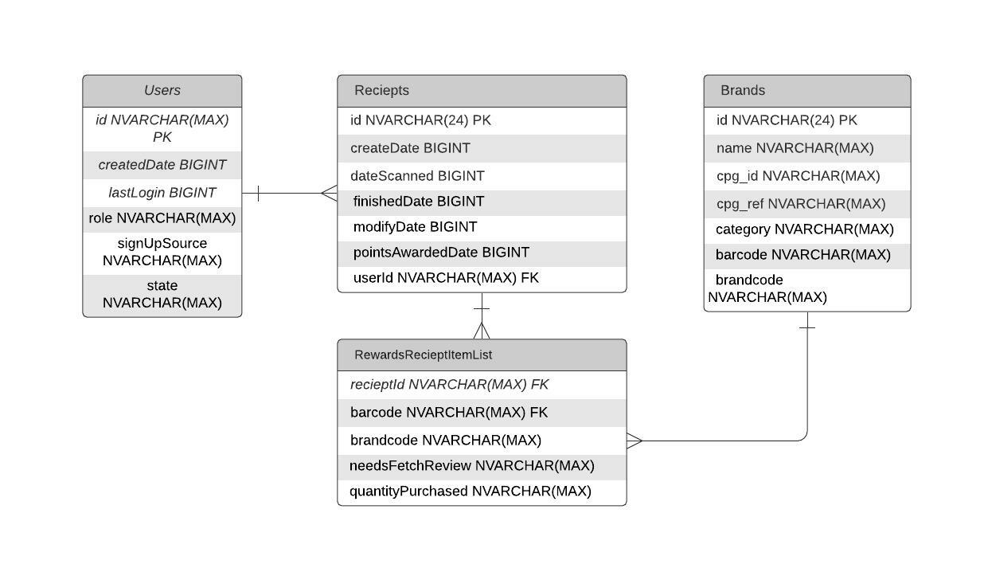
Review unstructured JSON data and diagram a new structured relational data model

Slide 3
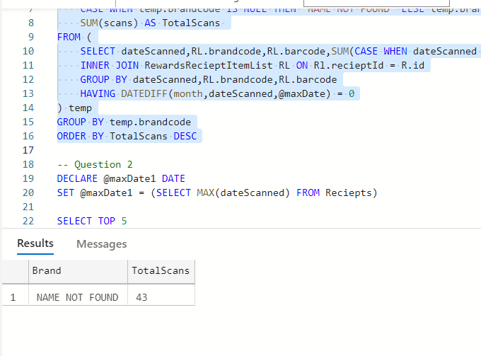
What are the top 5 brands by receipts scanned for most recent month?

Slide 4
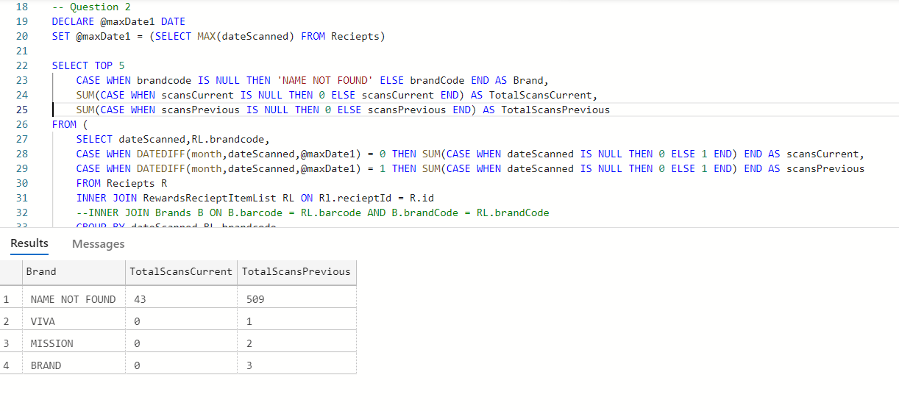
How does the ranking of the top 5 brands by receipts scanned for the recent month compare to the ranking for the previous month?

Slide 5
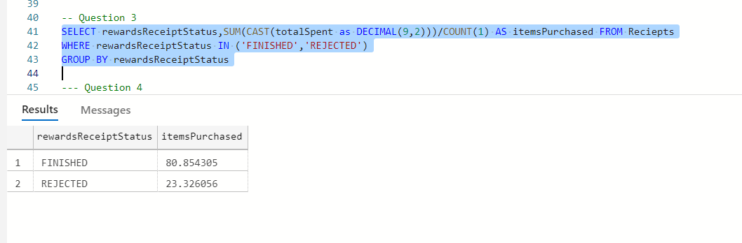
When considering average spend from receipts with 'rewardsReceiptStatus’ of ‘Accepted’ or ‘Rejected’, which is greater?

Slide 6
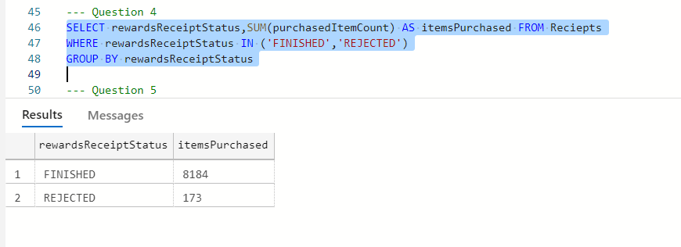
When considering total number of items purchased from receipts with 'rewardsReceiptStatus’ of ‘Accepted’ or ‘Rejected’, which is greater?

Slide 7
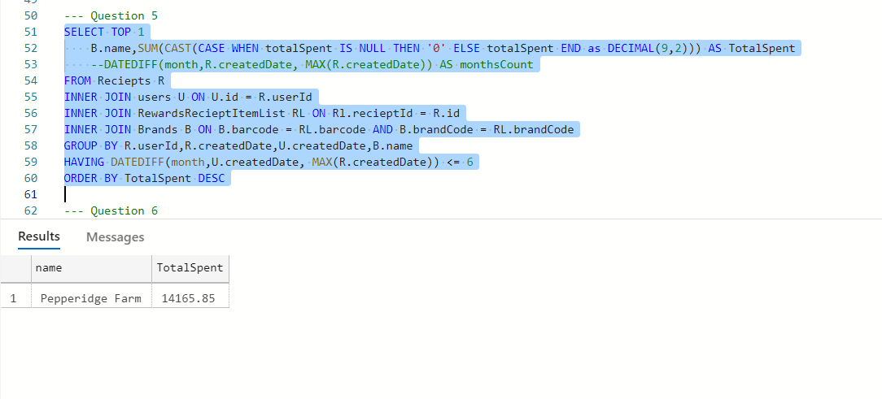
Which brand has the most spend among users who were created within the past 6 months?

Slide 8
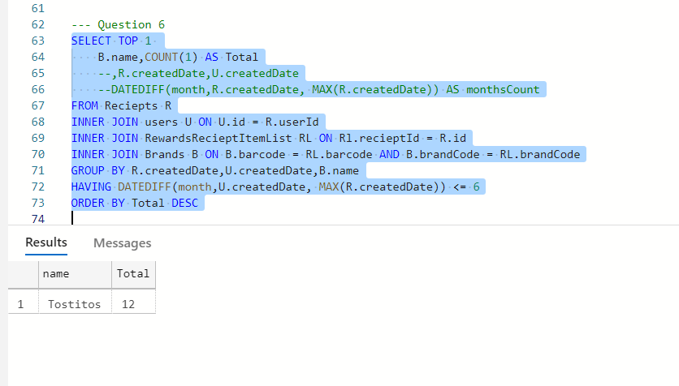
Which brand has the most transactions among users who were created within the past 6 months?

Slide 9
Evaluate Data Quality Issues in the Data Provided

Slide 10
Test Case 1: Created Date <= Last Login date in Users
Findings for TC 1:
a. No inconsistencies found for created and last login date
Test Case 2: Valid data in Users
Findings for TC 2:
a. active status has a value as fals

Slide 11
Test Case 3 & 4: Inconsistent data
Findings for TC 3 & 4:
a. Inconsistency found in Reciepts table & Brands
-brands not found in RewardsRecieptItemList table
b. Inconsistency found in Reciepts table & Users
- users not found in RewardsRecieptItemList table
c. Inconsistency found in price from Reciepts & RewardsRecieptItemList table

Slide 12
Test Case 3 & 5: Duplication in data
Findings for TC 5:
1. Duplication observed in User table, with multiple entries for userId attached in the document
2. No duplicates found in Reciepts & Brands table based on the unique id
Test Case 6: NullCheck
Findings for TC 6 : Null value found in all tables

